Slide 1
Linked List
Abu Saleh Musa Miah

Slide 2
Problem With Array
Fixed Length (Occupy a Block of memory) [Are also called Dense List]
To expand an Array
create a new array, longer in size and
copy the contents of the old array into the new array
Insertion or Deletion

Slide 3
Solution
Attach a pointer to each item in the array, which points to the next item
This is a linked list
An data item plus its pointer is called a node

Slide 4
Linked List
A linked list, or one-way list, is a linear collection of data elements , called nodes, where the linear order is given by means of pointer

Slide 5
Linked List
Each node is divided into two parts
First part contains the information of the element, and
Second part called the link field or nextpointer field contains the address of the next node in the list.

Slide 6
Linked Lists
A
B
C
∅
Head
A linked list is a series of connected nodes
Head : pointer to the first node
The last node points to NULL

Slide 7
Linked Lists
node
A
data
pointer
Each node contains at least
A piece of data (any type)
Pointer to the next node in the list

Slide 8
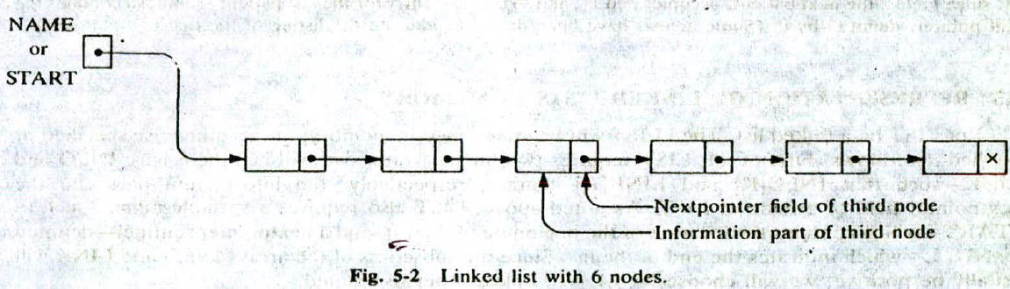

Slide 9
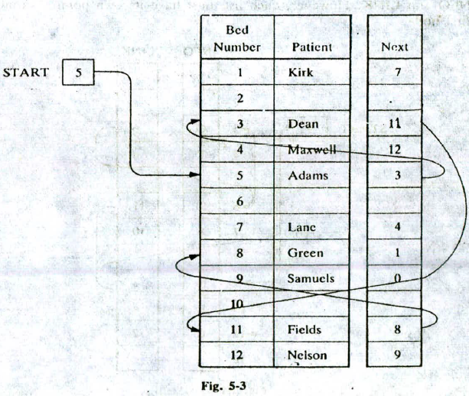

Slide 10
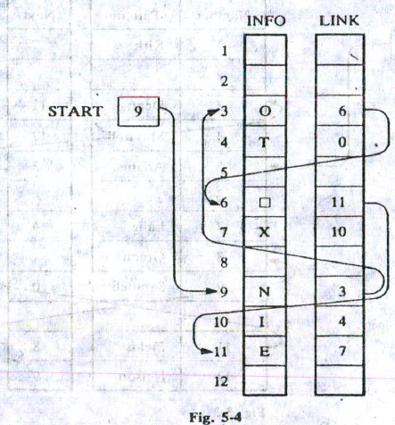
REPRESENTATION OF LINKED LISTS IN MEMORY
Let LIST he a linked list. Then LIST will be maintained in memory. unlcss otherwise specified Or implied, as follows. First of all, LIST requires two linear arrays—we will call them here INFO and LINK—such that INFO[K] and LINK[K] contain, respectively, the information part and the next pointcr field of a node of LIST.

Slide 11
REPRESENTATION OF LINKED LISTS IN MEMORY
EXAMPLE 5.2
Figure 5-4 pictures a linked list in memory where each node of the list contains a single character. We can
obtain the actual list of characters, or, in other words, the string, as follows:
START = 9, so INFO[9] = N is the first character.
LINKLO] = 3, so 1NF0131 0 is the second character.
LINK(31 = 6, so INFO(6] = Li (blank) is the third character.
LINK161 11, so INFO[ II) E is the fourth character.
LINKI! 11 = 7, so INFOI71 = X is the fifth character.
LINK[7] = 10, so INFOLIOJ = I is the sixth character.
LINK[ 101 4, so INFO[41 = T is the seventh character.
LINK(4] = 0. the NULL value, so the list has cniIcd.
In other words, NO EXIT is the character string.

Slide 12
Operation of Link List
Traversing.
Searching.
Inserting.
Deleting.
Sorting.

Slide 13
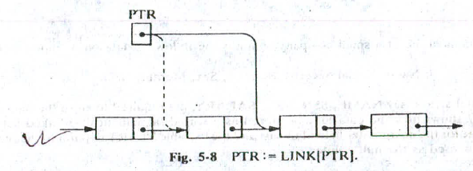
Traversing
Let LIST be a liir ed list in memory stored in linear arrays INFO arid LINK with START pointing to the first clement and NULL indicating the end of LIST.
PTR which points to the node that is currently being processe.
LINK [PTR] points to the next node to be processed. Thus the assignment.
PTR : = LINK[PTR]
moves the pointer to the next node in the list, as pictured in Fig. 5-8.

Slide 14
List Traversal
Head
Data
Link

Slide 15
Head
Data
Link
=
PTR

Slide 16
Head
Data
Link
=
PTR = PTR - > Link

Slide 17
List Traversal
Algorithm
set PTR = Head
Repeat step 3 and 4 while PTR ≠ NULL
Print PTR->DATA
Set PTR = PTR -> LINK
Stop

Slide 18
SEARCHING A LINKED LIST
LIST Is Unsorted:
Suppose the data in LIST are not necessarily sorted. Then one searches for ITEM in LIST by traversing through the list using a pointer variable P1'R and comparing ITEM with the contents INFO(PTR] of each node, one by one, of LIST. Before we update the pointer PTR by
PTR:= LINK[PTJ
we require two tests. First we have to check to see whether we have reached the end of the list; i.e.,
First we check to sec whether
PTR = NULL
If not, then we check to see whether
INFO[PTR] = ITEM

Slide 19
Search for an ITEM
Algorithm 5.2 SEARCH(INFO, LINK, START, ITEM, LOC)
This algorithm finds the location LOC of the node
where ITEM first appears in LIST, or Sets LOC = NULL.
1. Set PTR:=START.
2. Repeat Step 3 while PTR !=NULL:
3. If ITEM =INFO[PTR], then:
Set LOC:=PTR, and Exit.
Else:
Set PTR:=LINK[PTR]. [PTR now points to the next node.I
[End of If structure.]
[End of Step 2 loop.]
4. [Search is unsuccessful.] Set LOC: =NULL.
5. Exit.

Slide 20
Searching Algorithm when LIST Is Sorted
Suppose the data in LIST are sorted. Again we search for ITEM in LIST by traversing the list using a pointer variable PTR and comparing ITEM with the contents INFO[PTR) of each node, one by one of LIST.
Algorithm 5.3 SEARCH(INFO, LINK, START, ITEM, LOC)
1. Set PTR:=START.
2. Repeat Step 3 while PTR !=NULL:
3. If ITEM <INFO[PTR], then:
Set LOC:=PTR, and Exit.
Else:
Set PTR:=LINK[PTR]. [PTR now points to the next node.
[End of If structure.]
[End of Step 2 loop.]
4. [Search is unsuccessful.] Set LOC: =NULL.
5. Exit.

Slide 21
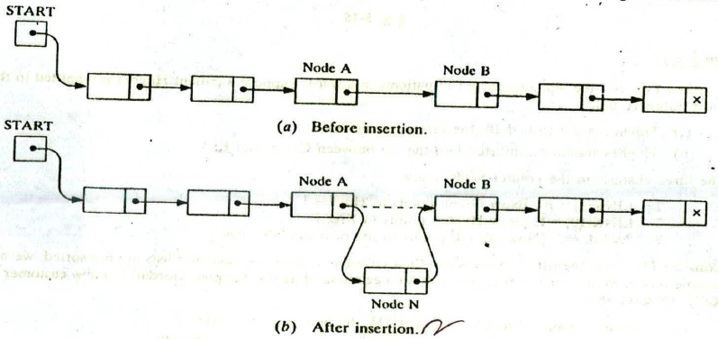
Insertion Into a Linked List
Head
Data
Link
Let LIST be a linked list with successive nodes A and B, as pictured in Fig. 5-14(a). Suppose a node N is to be inserted into the list between nodes A and B.

Slide 22
Insertion After a Given Node
Let Head be a pointer to a linked list in memory. Write an algorithm to insert ITEM so that ITEM follows the node with location LOC or insert ITEM as the first node when LOC == NULL

Slide 23
Insertion After a Given Node
Algorithm
If PTR == NULL , then Write Overflow and Exit
Set PTR -> DATA = ITEM
If LOC == NULL
Set PTR -> LINK = Head
Set Head = PTR
Else Set PTR->Link = LOC->Link
Set LOC->Link = PTR
Exit

Slide 24
Insertion to Beginning
Head
Data
Link
PTR
New Node

Slide 25
Insertion to Beginning
Head
Data
Link
PTR
New Node
PTR->Link = Head

Slide 26
Insertion to Beginning
Head
Data
Link
PTR
New Node
PTR->Link = Head , Head = PTR

Slide 27
Insertion Algorithm
INSFIRST(INFO, LINK, START, AVAIL, ITEM)
This algorithm inserts ITEM as the first node in the list.
I. [OVERFLOW?] If AVAIL = NULL, then: Write: OVERFLOW, and Exit.
2. [Remove first node from AVAIL list.]
Set NEW:= AVAIL and AVA1L:'LINK(AVAILj.
3. Set INFO[NEWI := ITEM. [Copies new data into new node.]
4. Set LINK[NEW] := START. [New node now points to original first node.]
5. Set START:= NEW. [Changes START so it points to the new nodc]
6. Exit.

Slide 28
Overflow and Underflow
Overflow : A new Data to be inserted into a data structure but there is no available space.
Underflow: A situation where one wants to delete data from a data structure that is empty.

Slide 29
Insertion at the Beginning
Let Head be a pointer to a linked list in memory. Write an algorithm to insert node PTR at the beginning of the List.

Slide 30
Insertion at the Beginning
Algorithm
If PTR == NULL , then Write Overflow and Exit
Set PTR -> DATA = ITEM
Set PTR -> LINK = Head -> LINK
Set Head = PTR
Exit

Slide 31
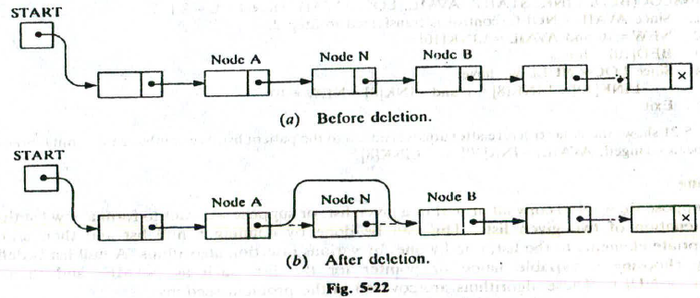
Deletion Algorithm
Suppose our linked list is maintained in memory in the form.
LIST(INFO. LINK, START, AVAIL)

Slide 32
Delete the Node Following a Given Node
Write an Algorithm that deletes the Node N with location LOC. LOCP is the location of the node which precedes N or when N is the first node LOCP = NULL.

Slide 33
Delete the Node Following a Given Node
Algorithm: Delete(Head, LOC, LOCP)
1 If LOCP = NULL then
Set Head = Head ->Link. [Deletes the 1st Node]
Else
Set LOCP->Link = LOC->Link [Deletes Node N]
2. Exit

Slide 34
Delete an Item
Let Head be a pointer to a linked list in memory that contains integer data. Write an algorithm to delete node which contains ITEM.

Slide 35
Delete an Item
To delete a Node [Node B] We have to Remember the Pointer to its predecessor [Node A]
1000
2000
3000
4000
5000
A
B
4000

Slide 36
Deletion of an ITEM
Algorithm
Set PTR=Head and TEMP = Head
Repeat step 3 while PTR ≠ NULL
If PTR->DATA == ITEM, then
Set TEMP->LINK = PTR -> LINK, exit
else
TEMP = PTR
PTR = PTR -> LINK
4. Stop

Slide 37
Deletion of an ITEM
Algorithm
If Head == NULL , then Write ITEM is not in the List, Exit
If Head ->Data == Item
Head = Head -> Link
Set PTR=Head and TEMP = Head

Slide 38
Deletion of an ITEM
Algorithm
4. Repeat step 4 while PTR ≠ NULL
If PTR->DATA == ITEM, then
Set TEMP->LINK = PTR -> LINK, exit
else
TEMP = PTR
PTR = PTR -> LINK
5. Stop

Slide 39
Header Linked Lists
A header linked list is a linked list which always contains a special node called header node
Grounded Header List: A header list where the last node contains the NULL pointer.
Header Node

Slide 40
Header Linked Lists
Circular Header List: A header list where the last node points back to the header node.
Header Node

Slide 41
Header Linked Lists
Pointer Head always points to the header node.
Head->Link == NULL indicates that a grounded header list is empty
Head->Link == Head indicates that a circular header list is empty

Slide 42
Header Linked Lists
The first node in a header list is the node following the header node
Circular Header list are frequently used instead of ordinary linked list
Null pointer are not used, hence all pointer contain valid addresses
Every node has a predecessor, so the first node may not require a special case.

Slide 43
Traversing a Circular Header List
Let Head be a circular header list in memory. Write an algorithm to print Data in each node in the list.

Slide 44
Traversing a Circular Header List
Algorithm
Set PTR = Head->Link;
Repeat Steps 3 and 4 while PTR ≠ Head
Print PTR->Data
Set PTR = PTR ->Link
Exit

Slide 45
Locating an ITEM
Let Head be a circular header list in memory. Write an algorithm to find the location LOC of the first node in Head which contains ITEM or return LOC = NULL when the item is not present.

Slide 46
Locating an ITEM
Algorithm
Set PTR = Head->Link
Repeat while PTR ->Data ≠ ITEM and PTR ≠ Head
Set PTR = PTR ->Link
3. If PTR->Data == ITEM then
Set LOC = PTR
else
Set LOC = NULL
4. Exit

Slide 47
Other variation of Linked List
A linked list whose last node points back to the first node instead of containing a NULL pointer called a circular list

Slide 48
Applications of Linked Lists
Polynomial Representation and operation on Polynomials
Ex: 10 X ⁶ +20 X ³ + 55
Sparse Matrix Representation
0 0 11
22 0 0
0 0 66

Slide 49
Sparse Matrix
A sparse matrix is a very large matrix that contains lot of zero’s. In order to save storage space, a sparse matrix stores only the nonzero elements.

Slide 50
Linked list representation Sparse Matrix
m n --
i j val
i j val Null
4 4 --
0 2 5
3 2 8 Null

Slide 51
Linked list representation Sparse Matrix
ROWLINK
i
j
aij
COLLINK

Slide 52
Linked list representation Sparse Matrix
0
2
5
1
0
2
1
7
3
9
2
3
1
3
2
8

Slide 53
Two-Way List
What we have discussed till now is a one-way list [ Only one way we can traversed the list]
Two-way List : Can be traversed in two direction
Forward : From beginning of the list to end
Backward: From end to beginning of the list

Slide 54
Two-Way List
A two-way list is a linear collection of data element called nodes where each node N is divided into three parts:
A information field INFO which contains the data of N
A pointer field FORW which contains the location of the next node in the list
A pointer field BACK which contains the location of the preceding node in the list

Slide 55
Two-Way List
List requires two pointer variables:
FIRST: which points to the first node in the list
LAST: which points to the last node in the list
INFO field
BACK pointer
FORW pointer

Slide 56
Two-Way List
FIRST
LAST

Slide 57
Two-Way List
Suppose LOCA and LOCB are the locations of nodes A and B respectively in a two-way list.
The statement that node B follows node A is equivalent to the statement that node A precedes node B
Pointer Property: LOCA->FORW = LOCB if and only if LOCB->BACK = LOCA

Slide 58
Two-Way List
FIRST
LAST
A
B
Forward Pointer Node A
Backward Pointer Node A

Slide 59
Two-Way List
FIRST
LAST
A
B
LOCA
LOCB
LOCA->FORW = LOCB if and only if LOCB->BACK = LOCA

Slide 60
Operation in two-way list
Traversing
Searching
Deleting
Inserting

Slide 61
Deletion in Two-Way List
DELETE NODE B
FIRST
LAST
A
B
C
LOCB
LOCB->BACK->FORW
=
LOCB->FORW

Slide 62
Deletion in Two-Way List
DELETE NODE B
FIRST
LAST
A
B
C
LOCB
LOCB->FORW->BACK
=
LOCB->BACK

Slide 63
Insertion in Two-Way List
INSERT NODE NEW
LOCA->FORW->BACK = NEW
NEW->FORW = LOCA->FORW
FIRST
LAST
A
B
C
LOCA
LOCA->FORW = NEW
NEW->BACK = LOCA
NEW

